Slide 1

Tesco Grocery 1.0 Dataset vs. Income

Slide 2
CONTENTS
INTRODUCTION TO TESCO DATASET
AVERAGE PURCHASE/CONSUMPTION OF BEER,WINE/ALCOHOL
DESCRIBING INCOME DATASET
CORRELATIONS BETWEEN INCOME AND FOOD CATEGORIES
CORRELATIONS BETWEEN DIABETES AND NUTREINTS/FOOD CATEGORIES
LIMITATIONS AND ASSUMPTIONS
CONCLUSION

Slide 3
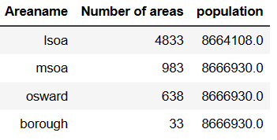
INTRODUCTION TO TESCO DATASET
The Dataset contains information on the things that 1.6 million fidelity card owners bought in 2015 at 411 Tesco locations in London.
The greater London is divided into spatial granularities:-
LSOA(Lower Super Output Areas)
MSOA(medium Super Output Areas)
Borough
Ward

Slide 4
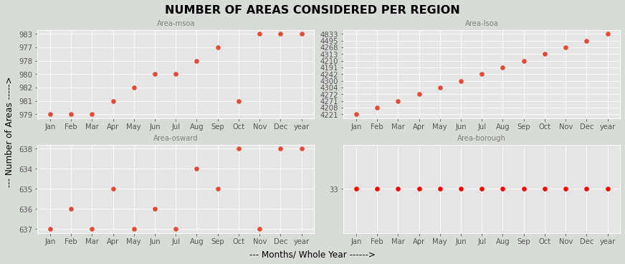
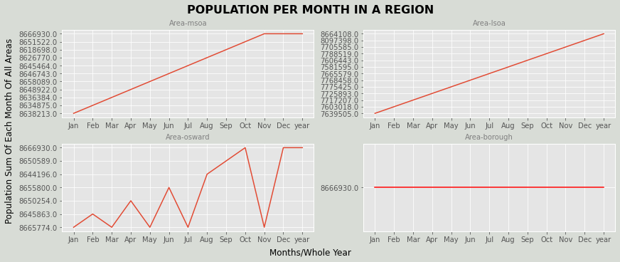
Although the areas and population considered for each month may vary by region, when considering the overall population for the year, all regions have the same population.

Slide 5
Introduction contd….
Total datasets contains 52 files(12 files for each month for four areas and one year long file).
For each region, we have information on the volume of transactions as well as the typical food item's nutritional characteristics, such as its typical calorie intake and nutrient composition.
In order to avoid overlapping the food categories are categorized into 17 classes and nutrients into fat, saturate, salt, sugar, protein, carb and fibre.
Additionally, when possible, calculated standard deviation ,confidence interval and percentiles for the dataset and provided the corresponding values.
In addition to Tesco dataset we use ONS datasets for finding the insights between the two datasets.

Slide 6
LIMITATIONS AND ASSUMPTIONS
Data is collected only from fidelity card owners therefore they don’t represent whole population.
Northern part of London has higher number of Tesco stores. As a result, some areas of the city exhibit low penetration.
representativeness(a )= customers(a) / population(a)
It does not represent full picture of daily food consumption it only tells about habits at area level.
From data we can’t estimate the diet of individual customers. So, the nutrient values are provided as averages over all the items purchased by the residents of an area.

Slide 7
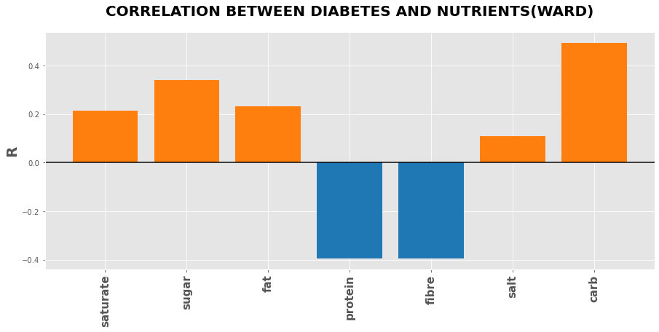
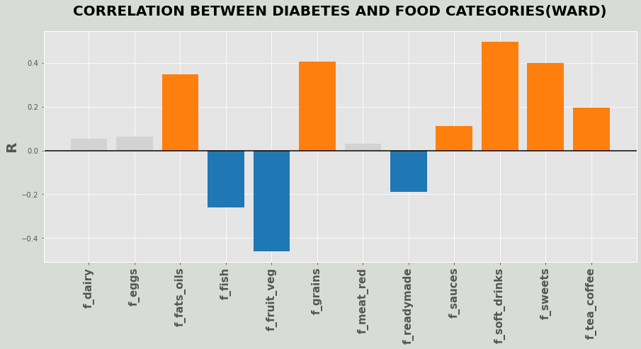
CORRELATIONS BETWEEN DIABETES AND NUTREINTS/FOOD CATEGORIES
Consuming foods like fish, fruits, vegetables that are rich in protein, fibre will have less chances of getting diabetes.
Consuming excessive foods like sweets, soft drinks, grains that are rich in sugar, carb, fat will have more chances of getting diabetes

Slide 8
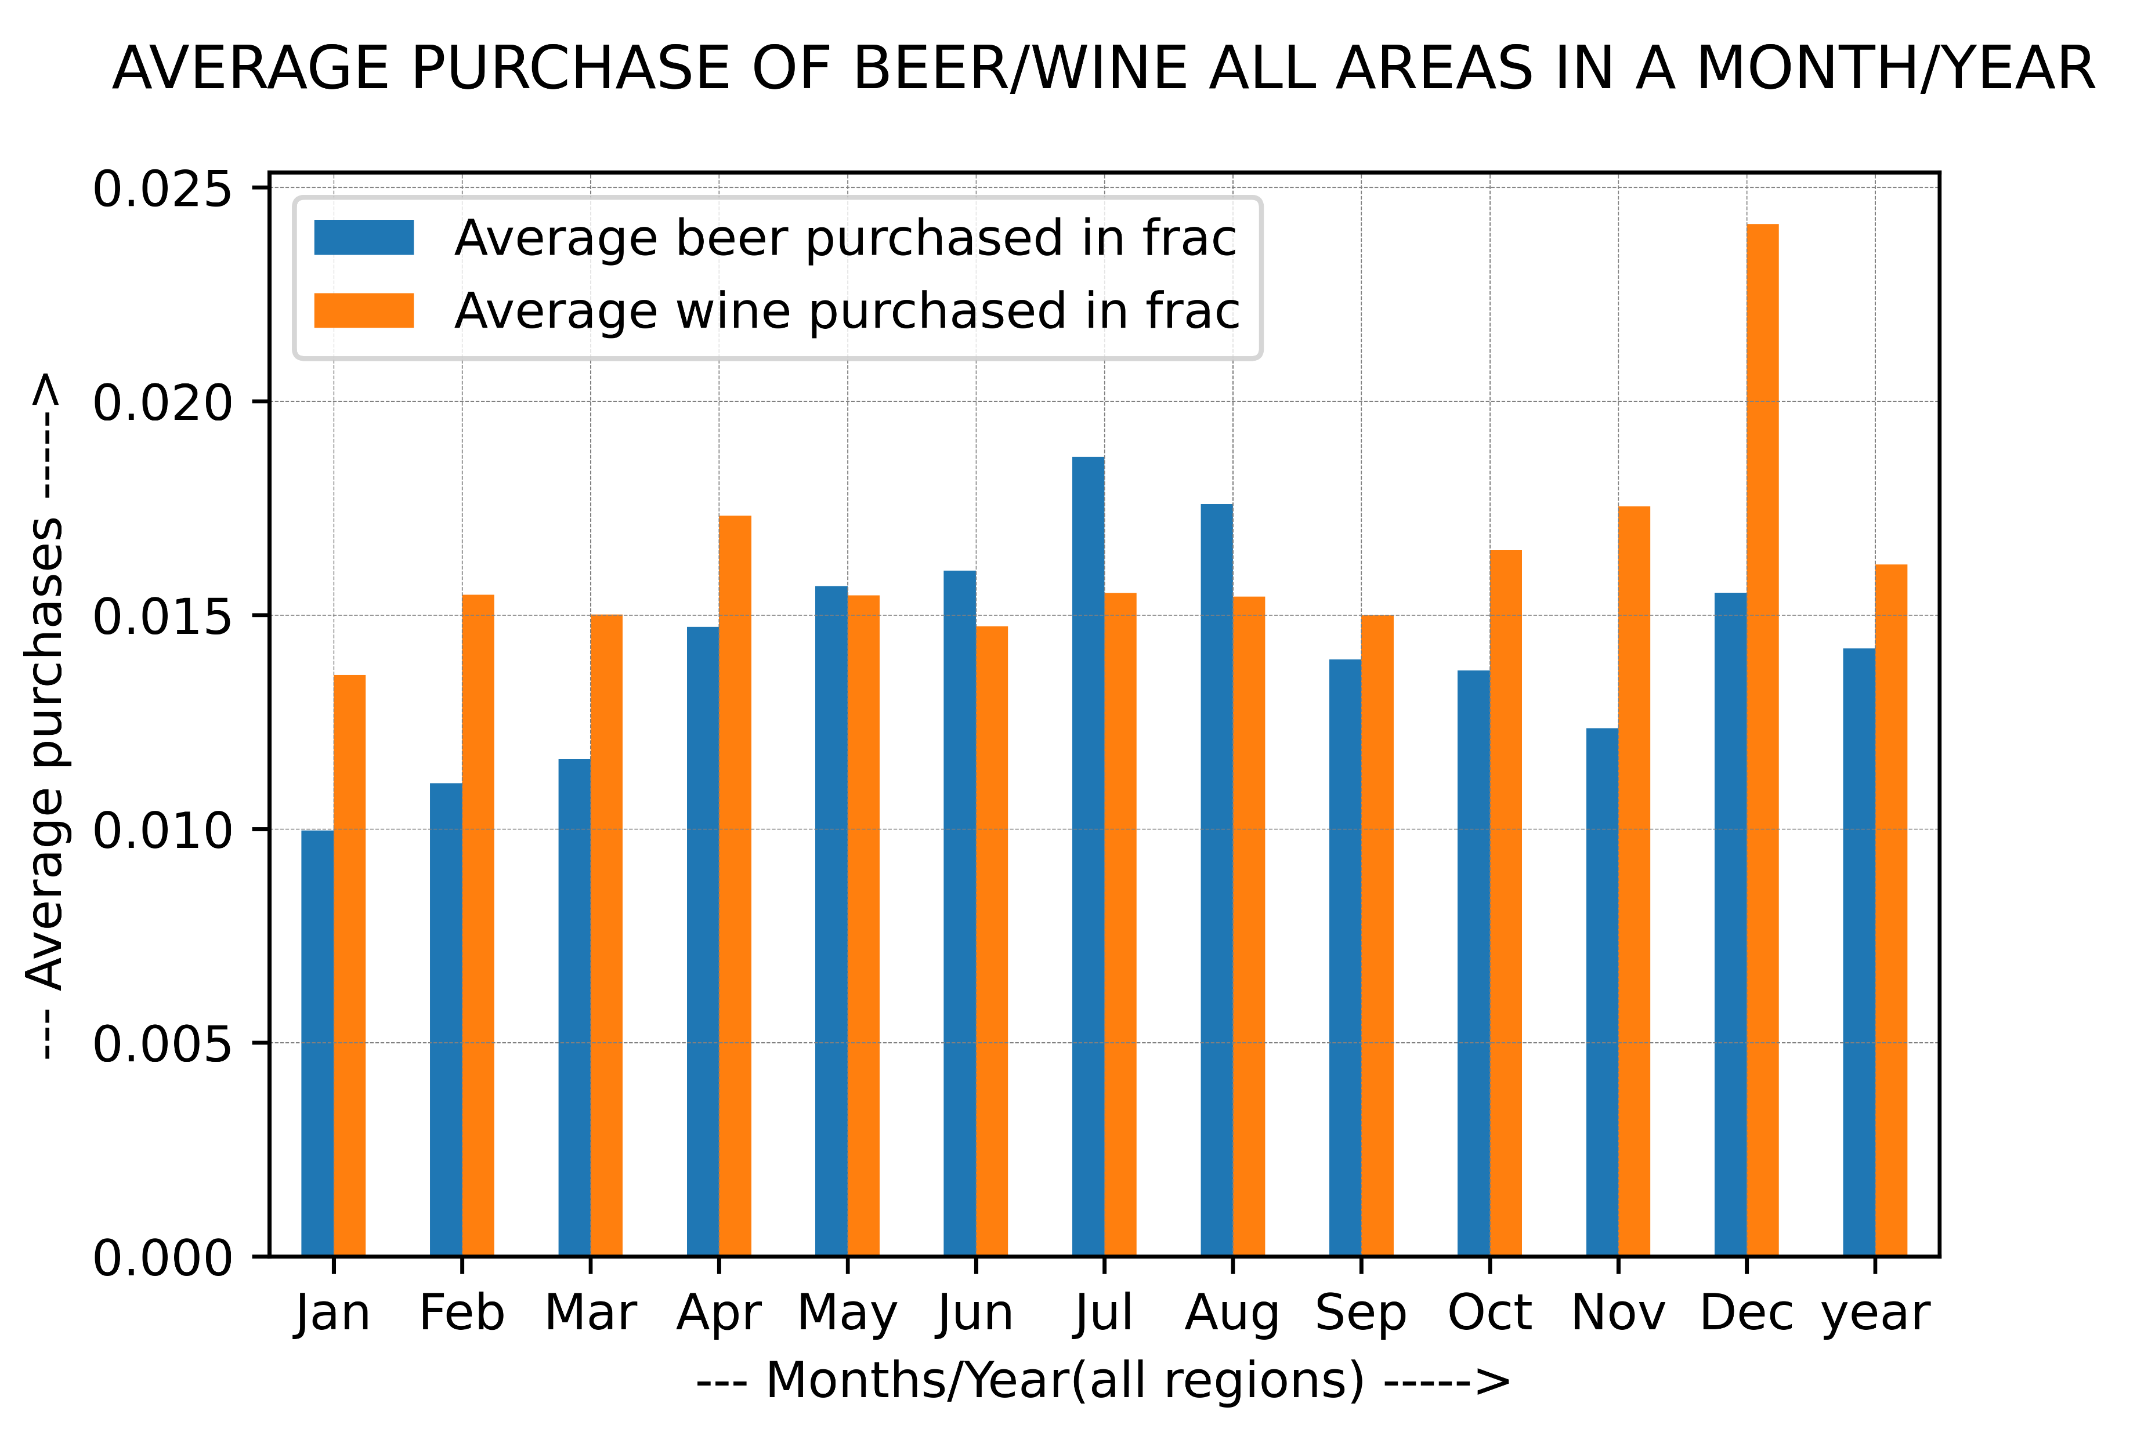
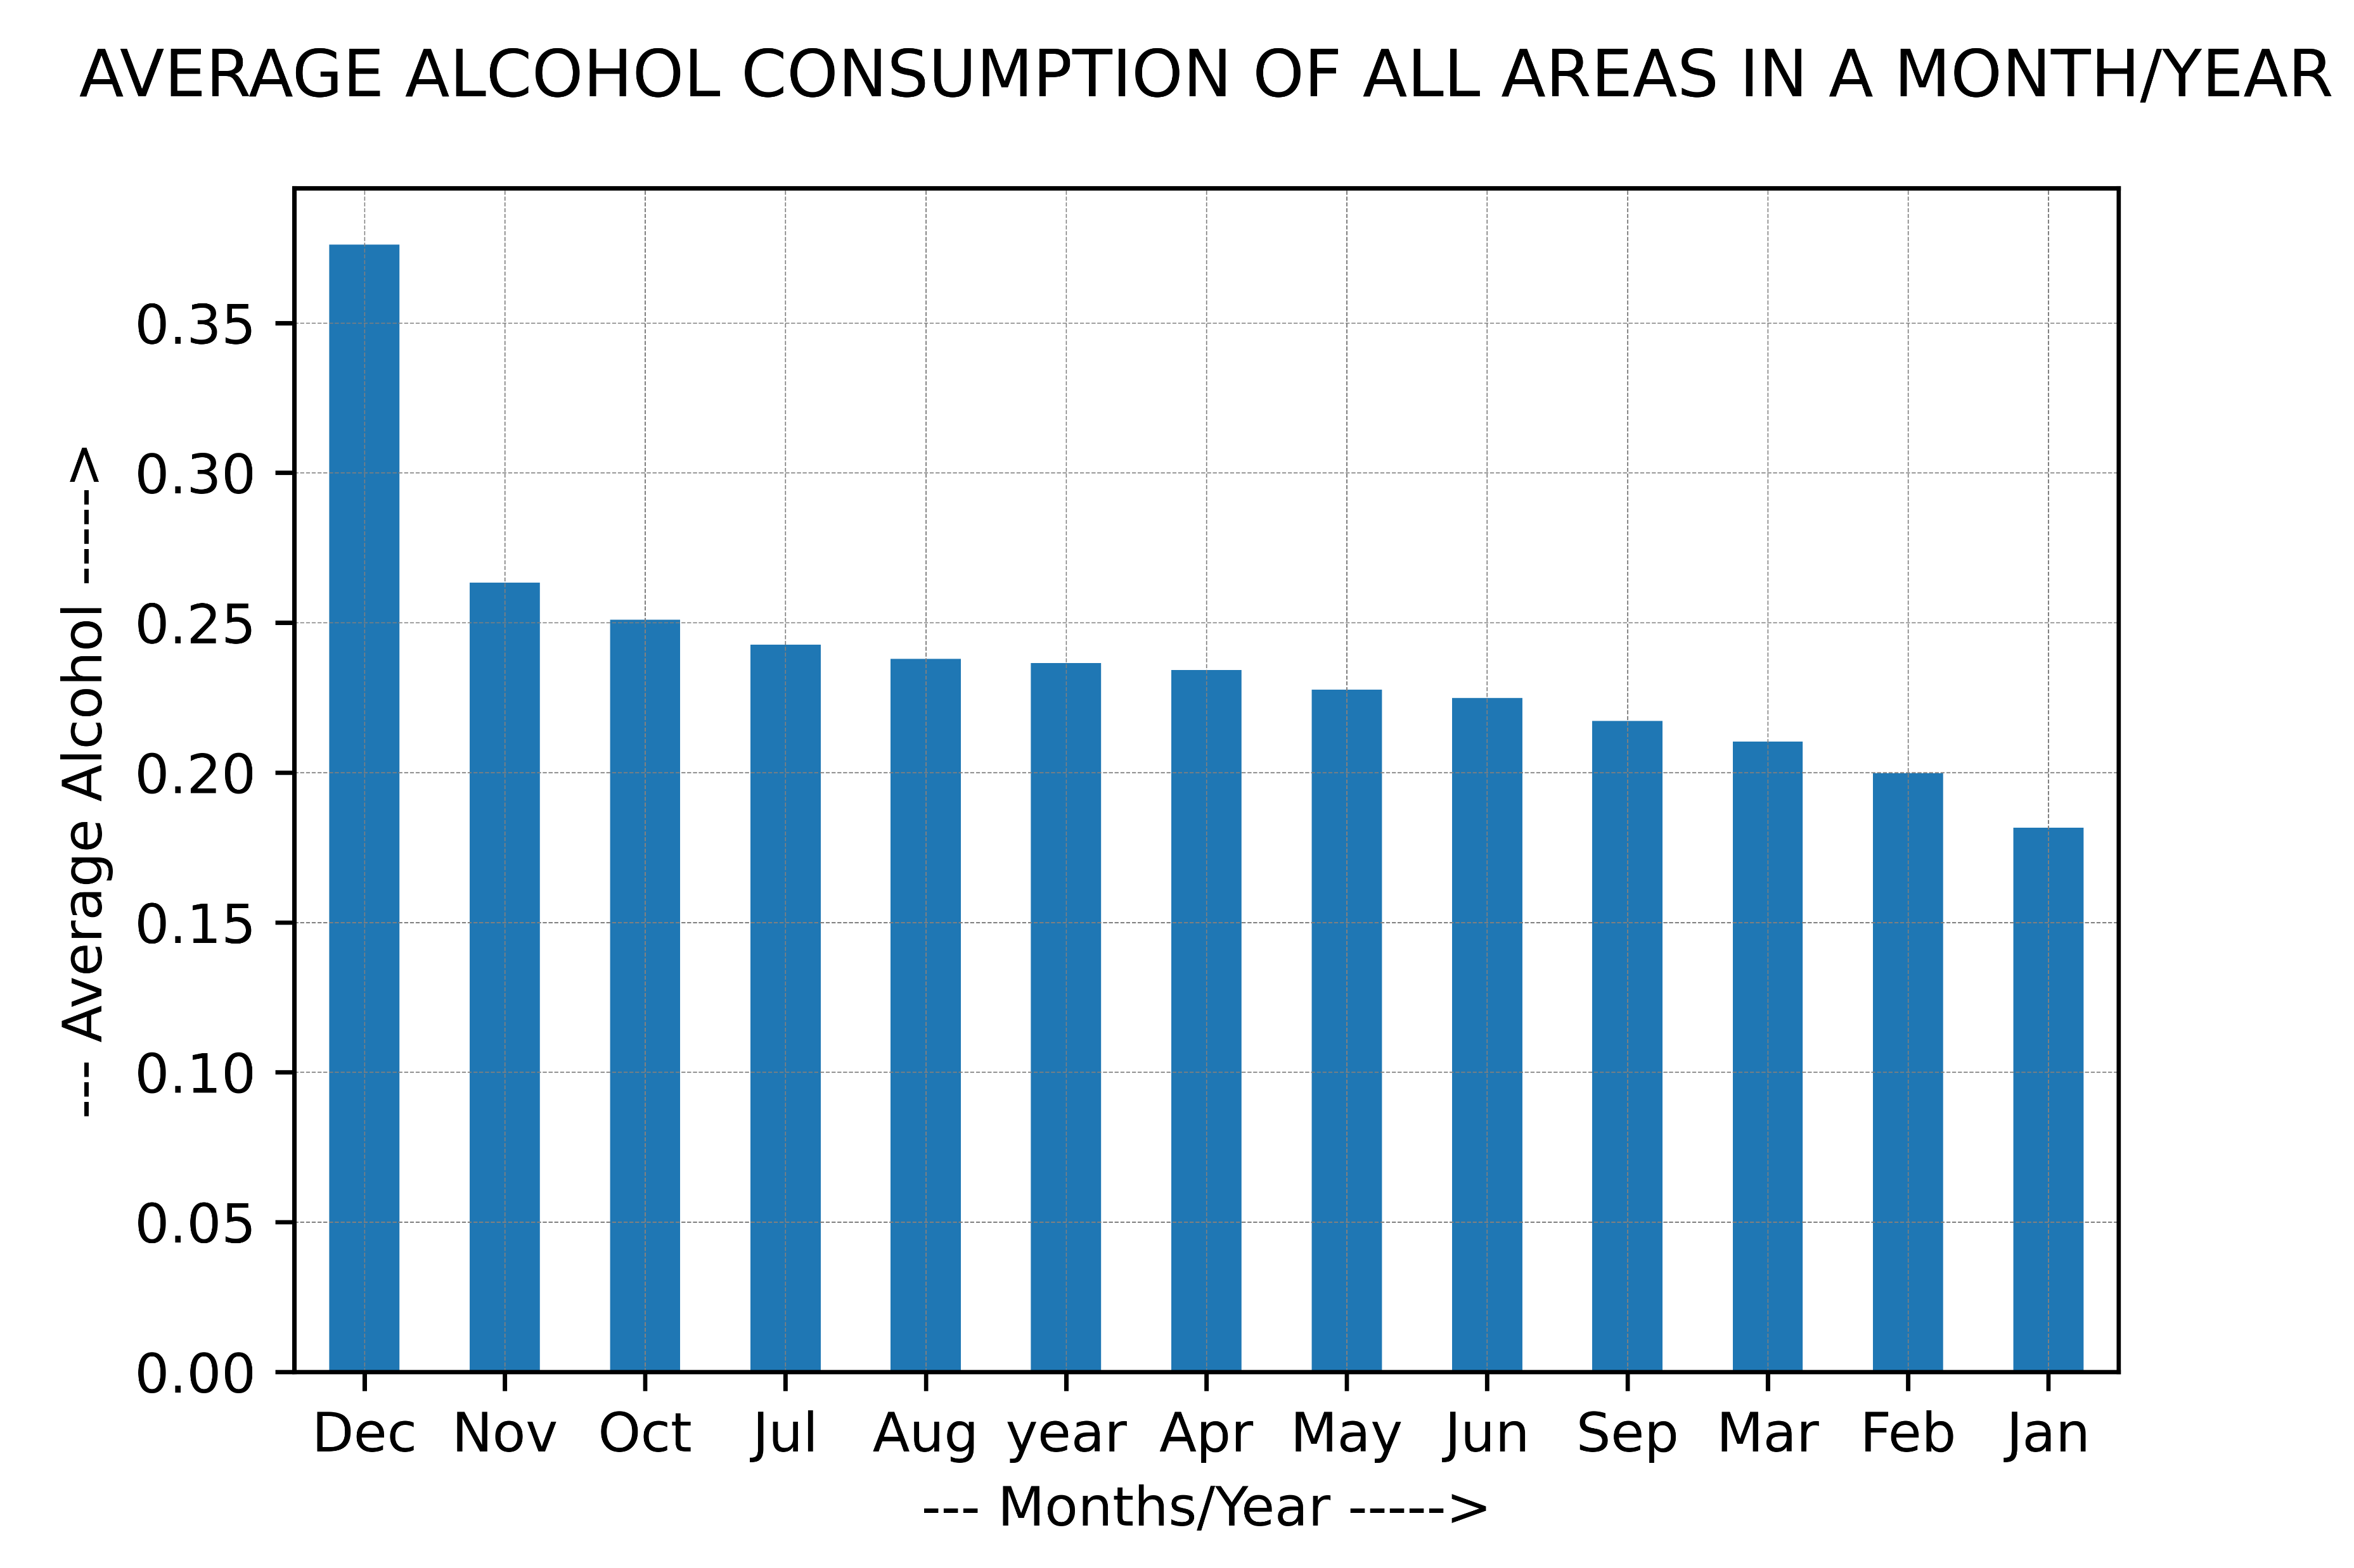
AVERAGE PURCHASE/CONSUMPTION OF BEER,WINE/ALCOHOL
Generally the beer is more purchased in summer(May, June, July, August) than compared to wine. overall Wine is purchased more compared to beer.
Alcohol consumption is more in December due to Christmas(as everyone spends time with their families).

Slide 9
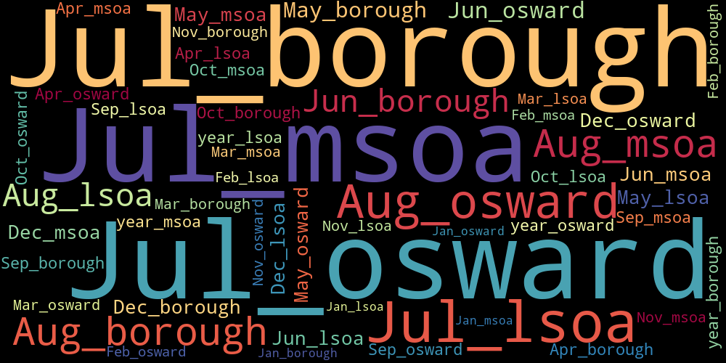
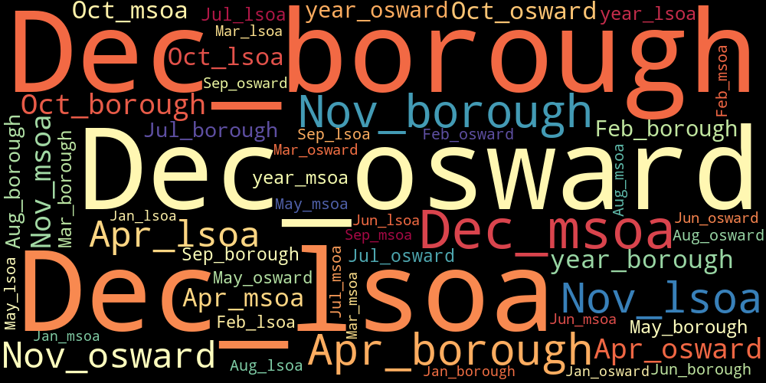
The words in the word cloud that are displayed in larger fonts represent product that been purchased more in a given month and region, while the words in smaller fonts represent products that have been purchased less in a given month and region.
Top figure shows average purchases of beer
Below figure shows average purchases of wine

Slide 10
DESCRIBING INCOME DATASET
Regional gross disposable household income dataset describes the average income of each person not household.
The income values in the dataset are after the taxes are paid.
The income mentioned in the dataset are in pounds.
It tells the income of 15 years year 1997-2020 of borough area.

Slide 11
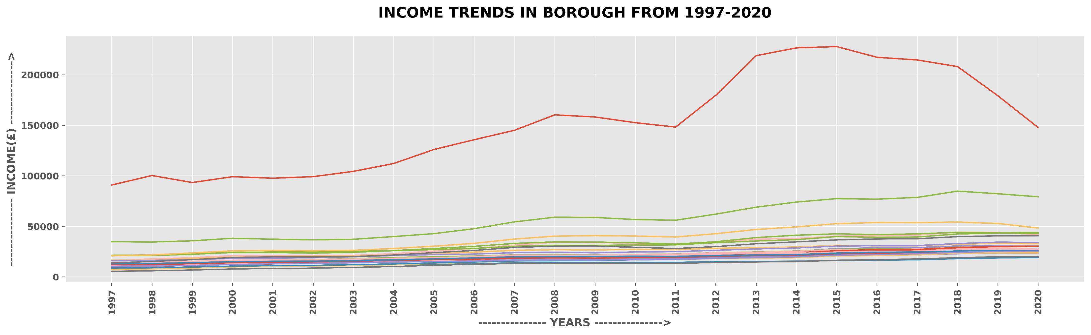
PRELIMINARY ANALYSIS
Income over all years has been plotted and observed that all the areas has different income
The income of individual has been increasing from 1997-2020
From dataset we can say they city of London, Kensington and Chelsea has more income compared to other areas hackney, Newham are low income areas.

Slide 12
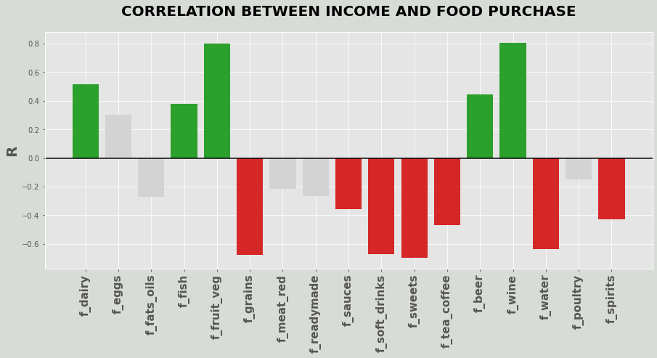
CORRELATIONS BETWEEN INCOME AND FOOD CATEGORIES
People with more income are buying more health food like dairy, fruits, vegetables, fish.
People with low income are buying unhealthy food like grains, sweets.
Fresh foods cost more as they require transportation and maintenance to keep them fresh. As a result, people with higher incomes are more likely to be able to afford these foods. However, this does not mean that only people with higher incomes consume fresh foods

Slide 13
CONCLUSION
Overall data analysis gives us an idea after considering assumptions and limitations, that how income of people determines which product to buy and type of food and diet they maintain.
Tells us how much alcohol is consumed according to seasons and geographical areas in which they reside.

Slide 14
THANK YOU

